Slide 1
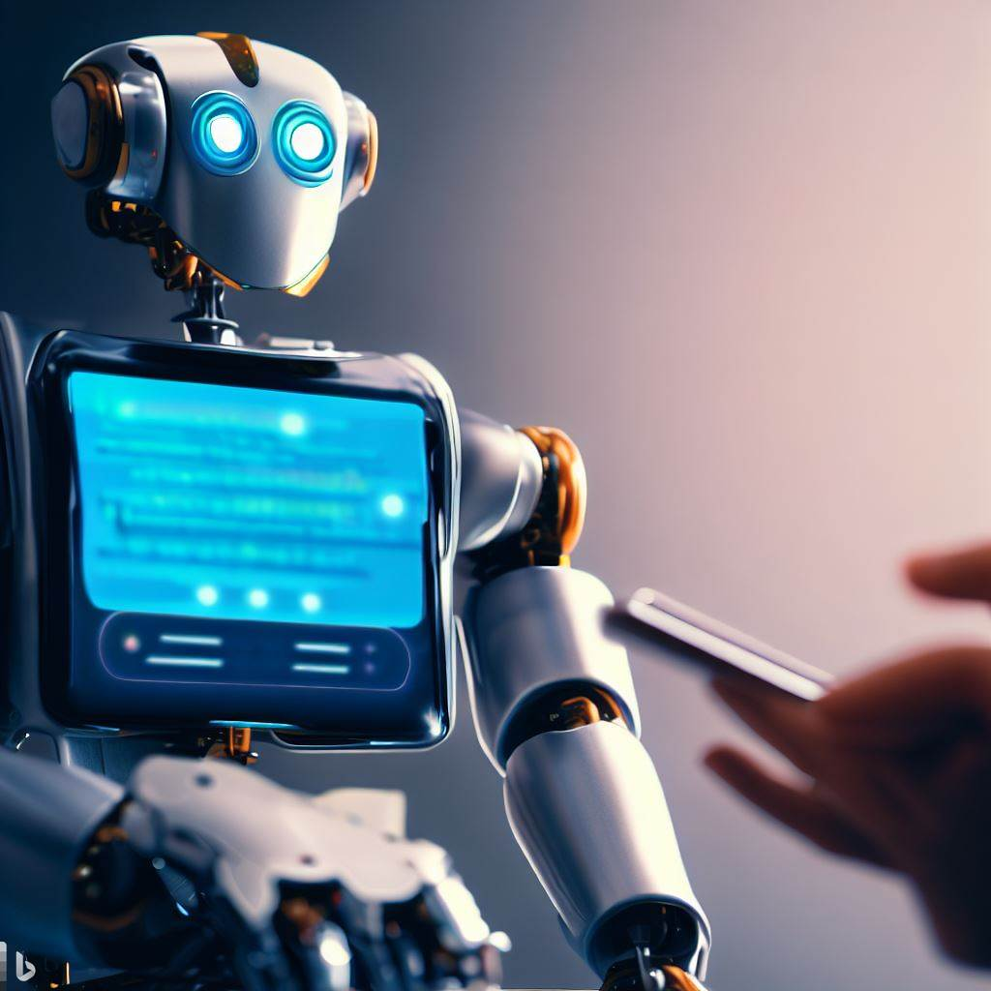
Chatgpt
A giant neural network of 175 billion parameters

Slide 2
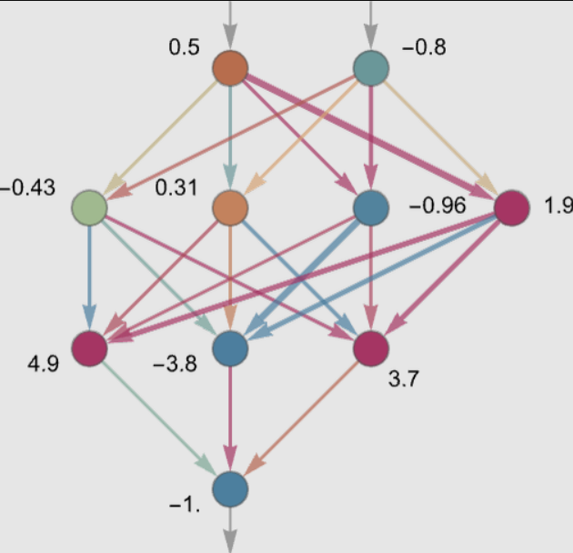
introduction
ChatGPT is basically a neural network of type “Deep Learning Neural Networks”
It tries to represents natural language in the form of neural network language
Although the architecture and design of neural networks is done by humans – but how it actually happens inside neural network is still partial science and partial mystery.
Most neural network methods are based on TRIAL and ERROR approach.
One interesting analogy is to call ChatGPT a “Stochastic Parrot” or “Autocomplete on steroids” – we will see soon why is that?
Also, we will have a look whether ChatGPT is becoming or will somehow become SENTIENT at some point ?

Slide 3
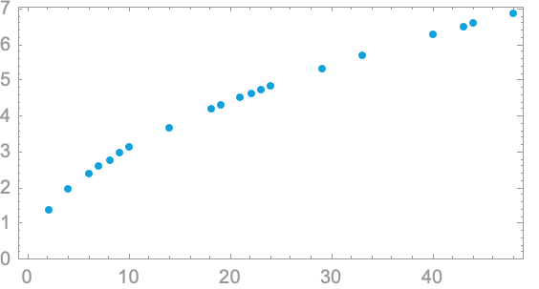
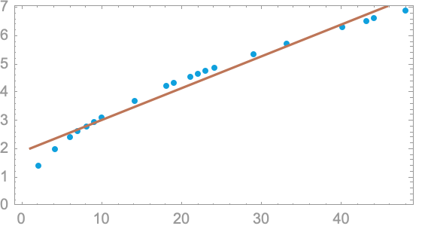
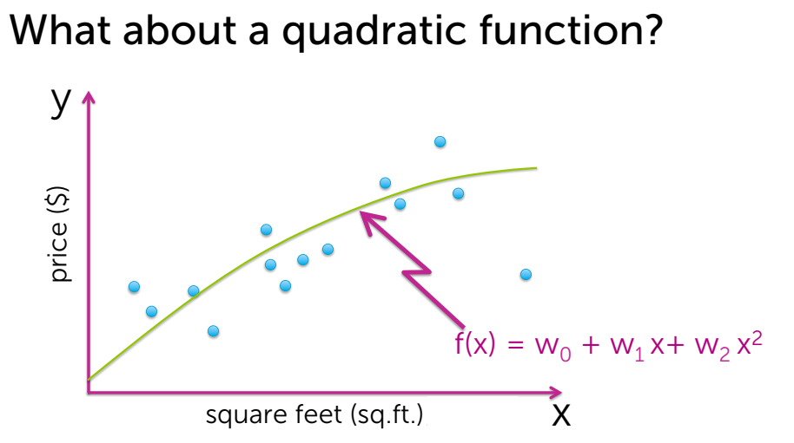
Simple Machine Learning Model

Slide 4
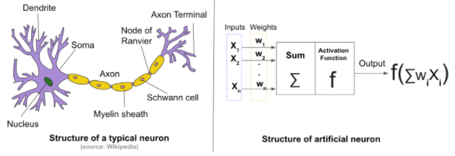
Neural networks
Neural networks are a type of machine learning algorithm that are inspired by the structure and function of the human brain
They are used for a wide range of applications, including image recognition, natural language processing, and predictive analytics
Original idea was presented by Frank Rosenblatt in 1957.

Slide 5
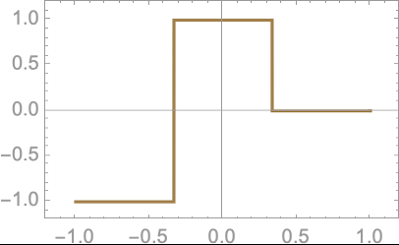
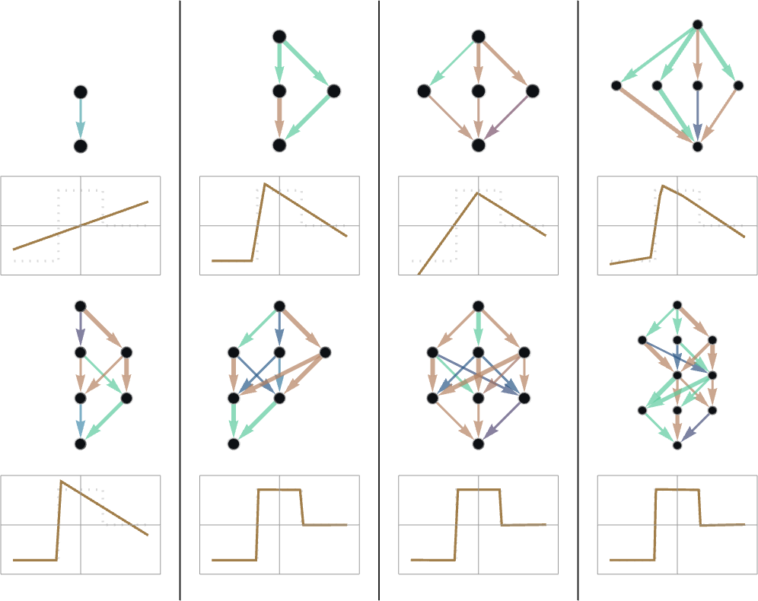
What is Learning in Neural Nets?
Example function
Learning here means “Finding weights that make the neural net successfully reproduce the examples given”
The basic idea is to supply lots of “input → output” examples to “learn from”—and then to try to find weights that will reproduce these examples.
Learning is measured by “How accurately target function is learnt by a neural network?
Learning the function by neural net

Slide 6
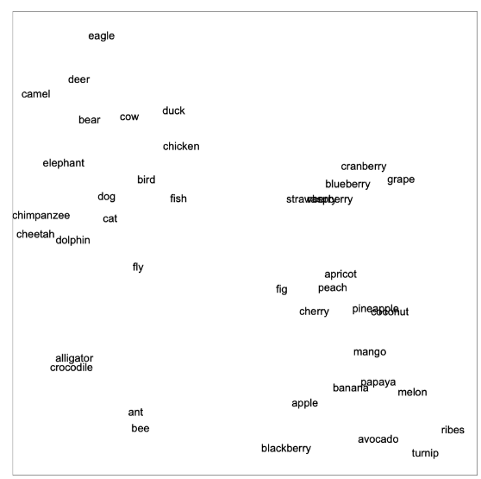
How ChatGPT works?
Embeddings
- Text is represented as numbers because neural networks work on numbers only
Nearby in meaning
Roughly 5 billion words from the web
Alligator is close to crocodile
One number is assigned to each of the most common 50,000 ENGLISH words
GPT-3 Network
Specialized neural network trained on 175 billion weights
Particularly trained for dealing with languages
Particular architecture is called as “Transformer”
Overall goal is to continue text in a “reasonable” way, based on what it’s seen from the training it’s had

Slide 7
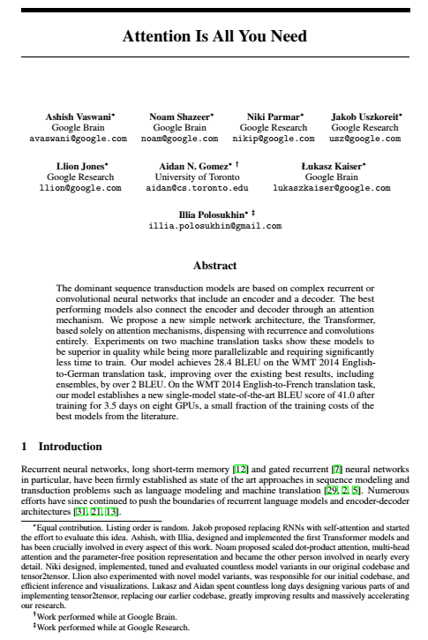
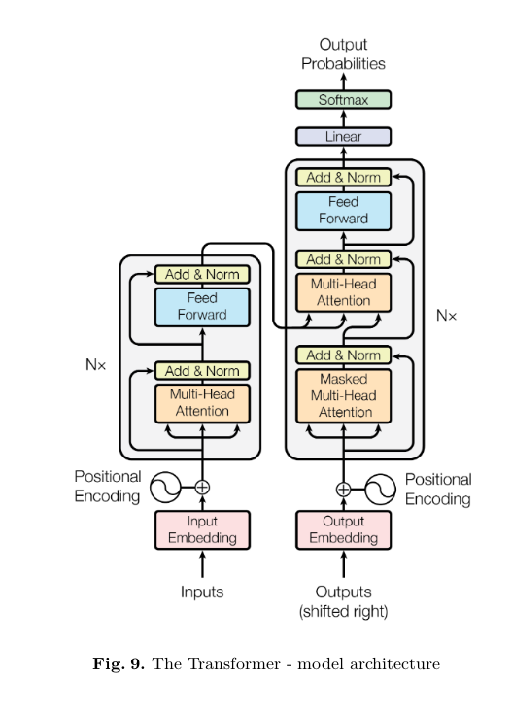
Attention is all you need!
This is the title of paper released in 2017 on Transformer neural networks which forms the original inspiration of various Large language models (LLMs); one of them being latest iteration of GPT3.5 or commonly called as “ChatGPT”.
A neural network is an effort to mimic human brain actions in a simplified manner. Attention Mechanism is also an attempt to implement the same action of selectively concentrating on a few relevant things, while ignoring others in deep neural networks.
Encoder – decoder architecture based on transformer neural networks is introduced in this paper.

Slide 8
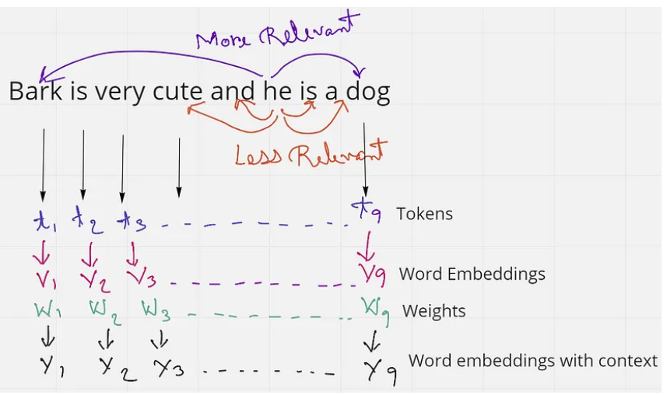
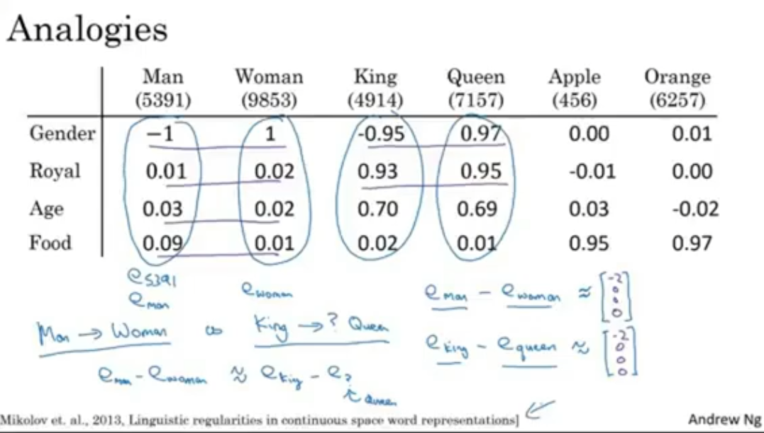
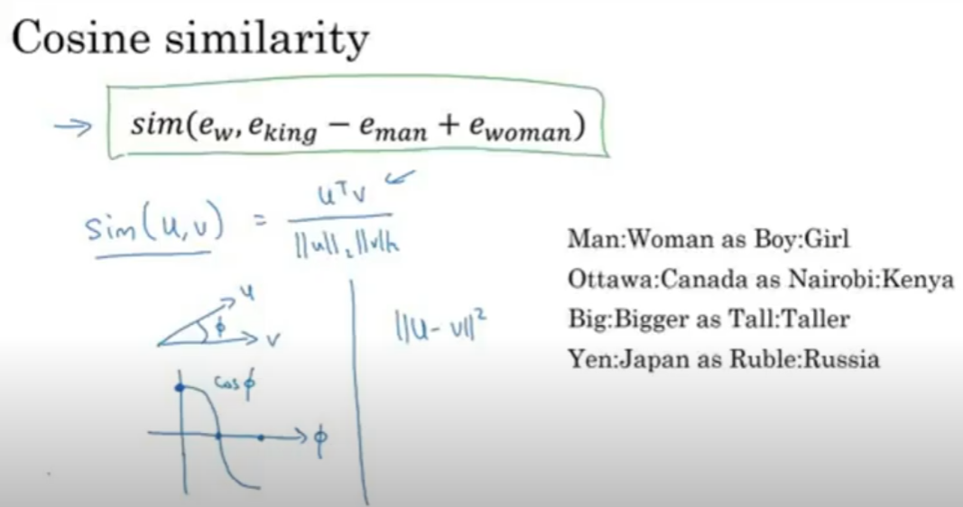
Self-Attention
This sentence has 9 words or tokens. If we just consider the word ‘he’ in the sentence, we see that ‘and’ and ‘is’ are the two words in close proximity to it. But these words do not give the word ‘he’ any context. Rather the words ‘Bark’ and ‘dog’ are much more related to ‘he’ in the sentence. From this, we understand that proximity is not always relevant, but context is more relevant in a sentence.
In an embedding space, similar words appear closer together or have similar embeddings. Such as the word ‘king’ will be more related to the word ‘queen’ and ‘royalty’, than with the word ‘zebra’. Similarly, ‘zebra’ will be more related to ‘horse’ and ‘stripes’, than with the word ‘emotion’.

Slide 9
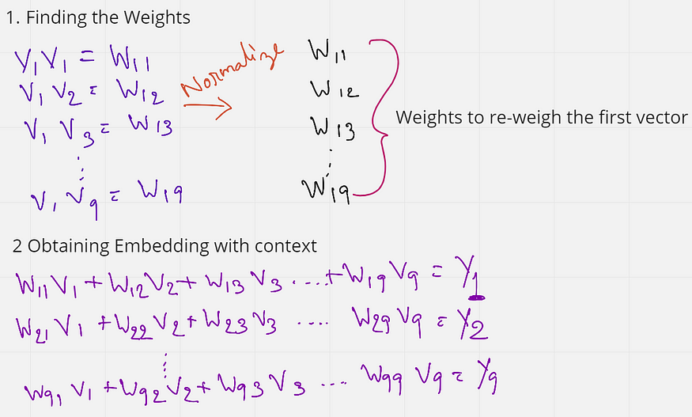
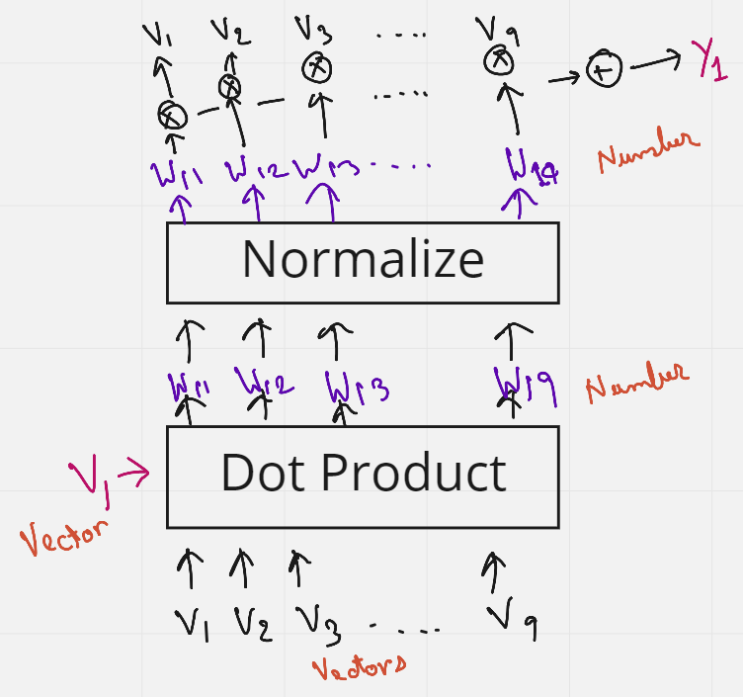
We first find the weights by multiplying (dot product) the initial embedding of the first word with the embedding of all other words in the sentence. These weights (W11 to W19) are also normalized to have a sum of 1. Next, these weights are multiplied with the initial embeddings of all the words in the sentence.
W11 V1 + W12 V2 + …. W19 V9 = Y1
W11 to W19 are all weights that have the context of the first word V1. So when we are multiplying these weights to each word, we are essentially reweighing all the other words towards the first word. So in a sense, the word ‘Bark’ is now tending more towards the words ‘dog’ and ‘cute’, rather than the word that comes right after it. And this, in a way gives some context.
What is interesting here is that no weights are trained, the order or proximity of the words have no influence on each other. Also, the process has no dependency on the length of the sentence, that is, more or fewer words in a sentence do not matter. This approach of adding some context to the words in a sentence is known as Self-Attention.

Slide 10
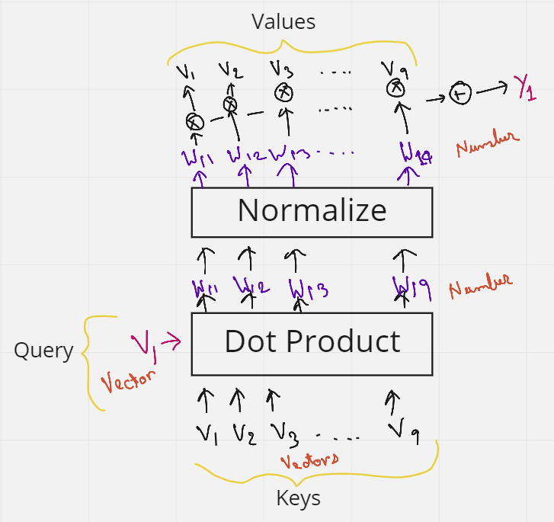
Query, Key & Values
Let's say we want to make all the words similar with respect to the first word V1. We then send V1 as the Query word. This query word will then do a dot product with all the words in the sentence (V1 to V9) — and these are the Keys. So the combination of the Query and the Keys give us the weights. These weights are then multiplied with all the words again (V1 to V9) which act as Values. There we have it, the Query, Keys, and the Values.
The issue with Self-Attention is that nothing is being trained. But maybe if we add some trainable parameters, the network can then learn some patterns which give much better context. This trainable parameter can be a matrix whose values are trained. So the idea of Query, Key, and Values was introduced.
Let's again consider the previous sentence — “Bark is very cute and he is a dog”. We saw earlier that the initial word embeddings (V) are used 3 times. 1st as a dot product between the first word embedding and all other words (including itself, 2nd) in the sentence to obtain the weights, and then multiplying them again (3rd time) to the weights, to obtain the final embedding with context. These 3 occurrences of the V’s can be replaced by the three terms Query, Keys, and Values.

Slide 11
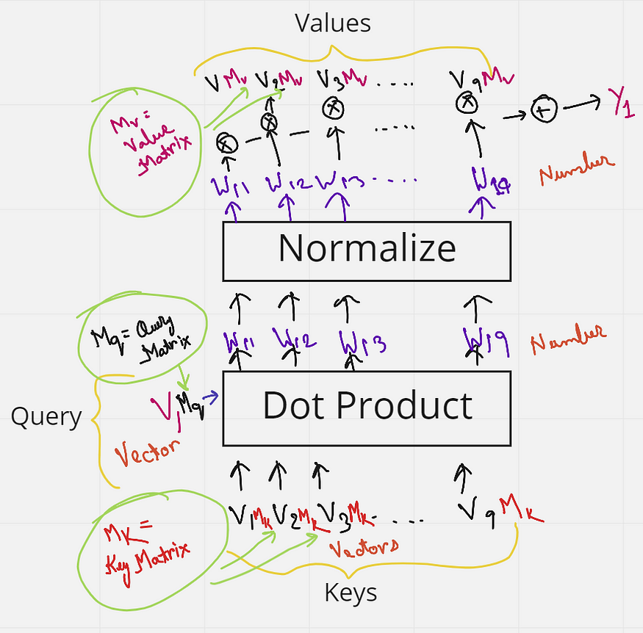
Trainable Matrix
But we have not added any matrix that can be trained yet. We know, if a 1 x k shaped vector is multiplied with a k x k shaped matrix, we get a 1 x k shaped vector as output. Keeping this in mind let's just multiply each key from V1 to V10 (each of shape 1 x k), with a matrix Mk (Key matrix) of shape k x k. Similarly, the query vector is multiplied with a matrix Mq (Query matrix) and the Values vectors are multiplied with Values matrix Mv. All the values in these matrices Mk, Mq, and Mv can now be trained by the neural network, and give much better context than just using self-attention.

Slide 12
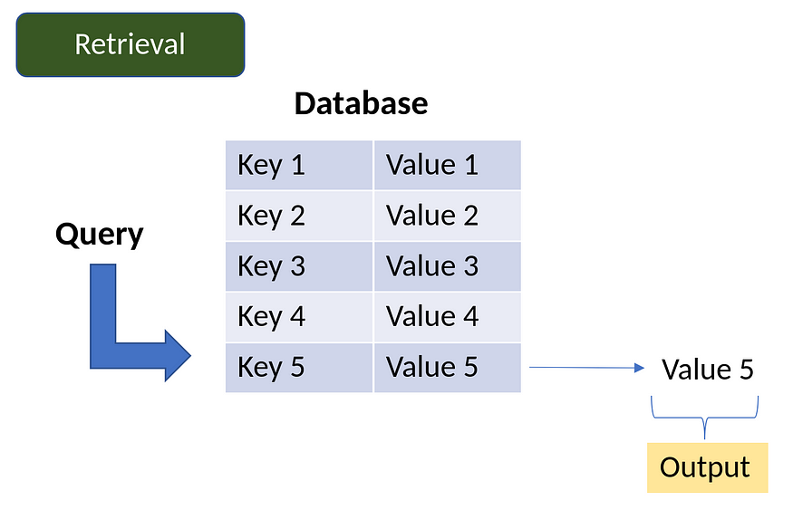
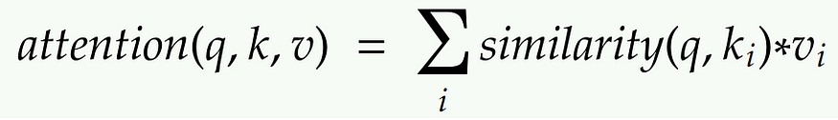
Database Analogy
So, in a database, if we want to retrieve some value vi based on a query q and key ki, some operations can be done where we can use a query to identify a key that corresponds to a certain value. Attention can be thought to be a similar process to this database technique but in a more probabilistic manner. This is demonstrated in the figure below. Suppose we send a query into the database, some operations will find out which key in the database is the most similar to the query. Once the key is located, it will send out the value corresponding to that key as an output. In the figure, the operation finds that the Query is most similar to Key 5, and hence gives us the value 5 as output.
The Attention mechanism is a neural architecture that mimics this process of retrieval.
1. The attention mechanism measures the similarity between the query q and each key-value ki.
2. This similarity returns a weight for each key value.
3. Finally, it produces an output that is the weighted combination of all the values in our database.
The only difference between database retrieval and attention in a sense is that in database retrieval we only get one value as input, but here we get a weighted combination of values. In the attention mechanism, if a query is most similar to say, key 1 and key 4, then both these keys will get the most weights, and the output will be a combination of value 1 and value 4.

Slide 13
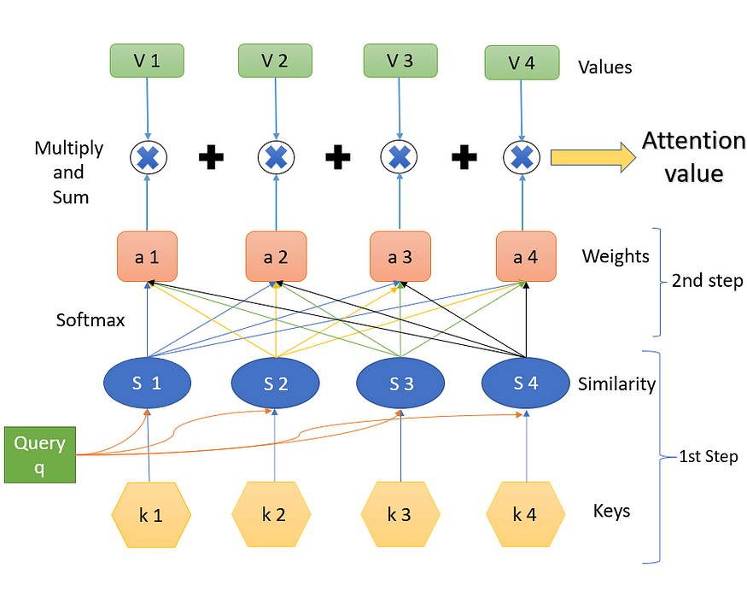
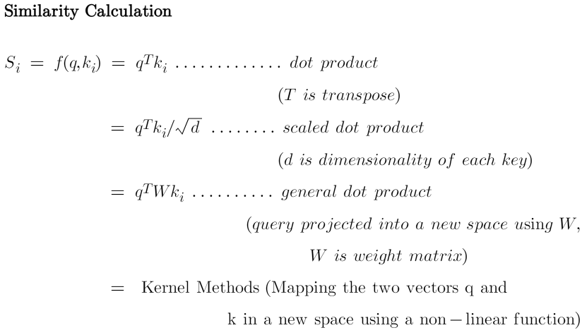
Attention
(The key values k are vectors, the Similarity values S are scalars, the weight values (softmax) values a are scalars, and the Values V are vectors)
Step-1
Step 1 contains the keys and the query and the respective similarity measures. The query q influences the similarity. What we have are the query and the keys, and we calculate the similarity. The similarity is some function of the query q and the keys k. Both the query and the keys are some embedding vectors. Similarity S can be calculated using various methods as below.

Slide 14
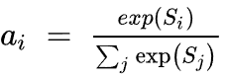
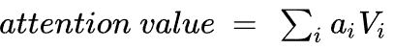
Attention Value
Similarity can be a simple dot product of the query and the key. It can be scaled dot product, where the dot product of q and k, is divided by the square root of the dimensionality of each key, d. These are the most commonly used two techniques to find the similarity. Often a query is projected into a new space by using a weight matrix W, and then a dot product is made with the key k. Kernel methods can also be used as a similarity.
Step-2
Step 2 is finding the weights a. This is done using ‘SoftMax’. The formula is shown below. (exp is exponential). The similarities are connected to the weights like a fully connected layer.
Step-3
Step 3 is a weighted combination of the results of the softmax (a) with the corresponding values (V). The 1st value of ‘a’ is multiplied with the first value of V and is then summed with the product of the 2nd value of ‘a’ with the 2nd value of Values V, and so on. The final output that we obtain is the resulting attention value that is desired.

Slide 15
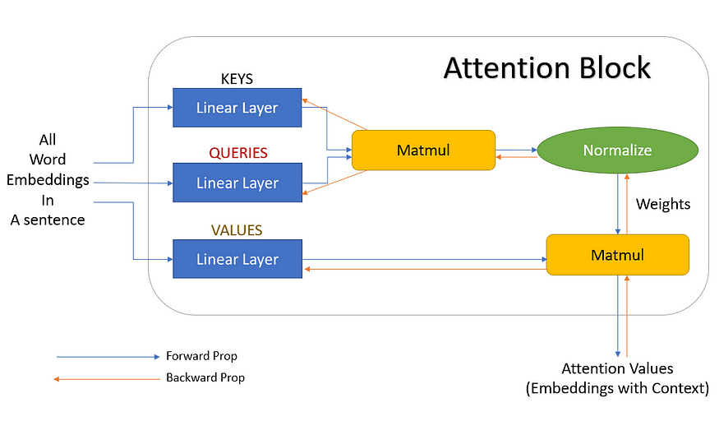
Attention Block
These linear layers do not have a ‘bias’ term, and hence are nothing but matrix multiplications. One of these layers is denoted as ‘keys’, the other as ‘queries’, and the last one as ‘values’. If a matrix multiplication is performed between the keys and the queries and are then normalized, we get the weights. These weights are then multiplied by the values, and summed up, to get the final attention vector. This block can now be used in a neural network and is known as the Attention block. Multiple such attention blocks can be added to provide more context. And the best part is, we can get a gradient backpropagating to update the attention block (weights of keys, queries, values).

Slide 16
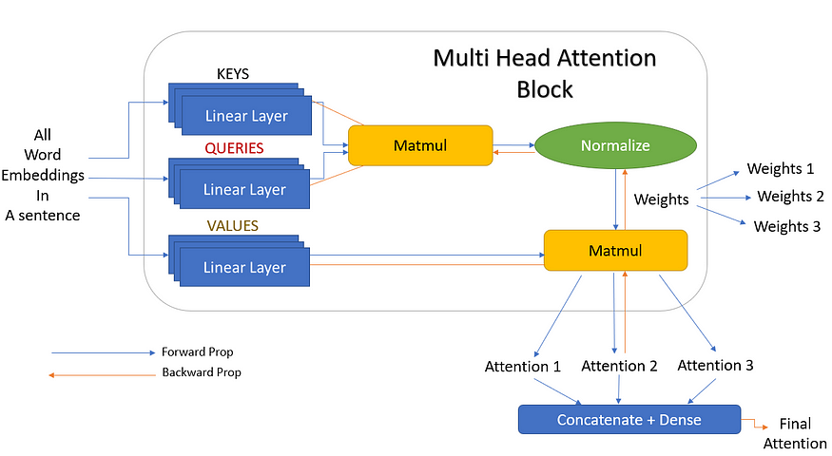
Multi-head Attention
Let's go back to the sentence — “Bark is very cute and he is a dog”. Here, if we take the word ‘dog’, grammatically we understand that the words ‘Bark’, ‘cute’, and ‘he’ should have some significance or relevance with the word ‘dog’. These words say that the dog’s name is Bark, it is a male dog, and that he is a cute dog. Just one attention mechanism may not be able to correctly identify these three words as relevant to ‘dog’, and we can say that three attentions are better here to signify the three words with the word ‘dog’.
So let's add more linear layers as the keys, queries, and values. These linear layers are training in parallel, and have independent weights to one another. So now, each of the values, keys, and queries gives us three outputs instead of one. These 3 keys and queries now give three different weights. These three weights then with matrix multiplication with the three values, to give three multiple outputs. These three attention blocks are finally concatenated to give one final attention output.

Slide 17
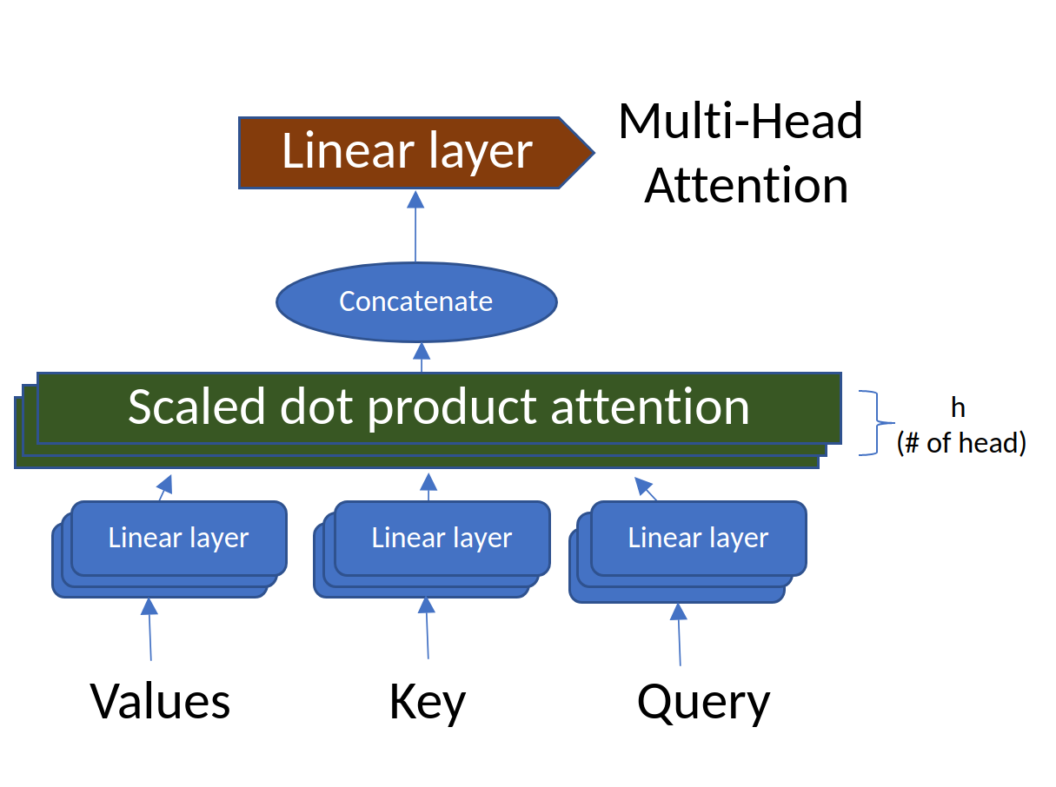
Multi-head Attention with ‘h’ layers
But 3 is just a random number we chose. In the actual scenario, these can be any number of linear layers, and these are called heads (h). That is there can be h number of linear layers giving h attention outputs which are then concatenated together. And this is exactly why it is called multi-head attention (multiple heads).

Slide 18
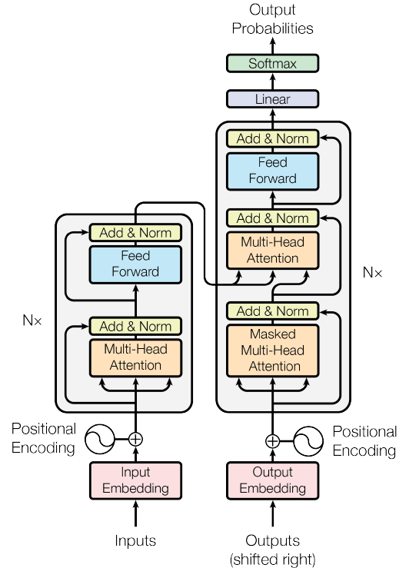
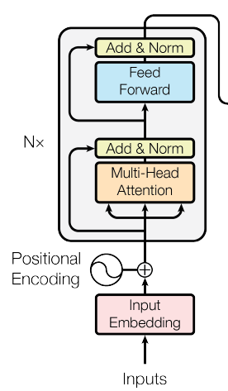
Transformer Network
The encoder network begins with the inputs. Here the entire sentence is fed at once. They are then embedded at the ‘input embedding’ block. Then a ‘positional encoding’ is added to each word in a sentence. This encoding is essential in understanding the position of each word in a sentence. Without positional embedding, the model will treat the entire sentence as just a bag full of words without having any sequence or meaning.
Encoder Block

Slide 19
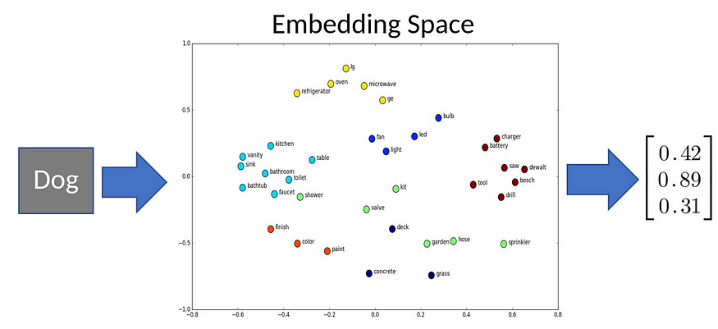
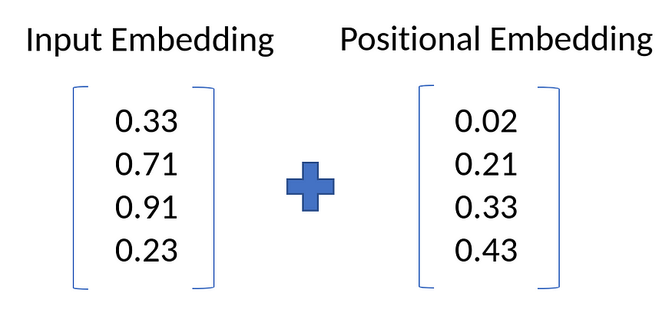
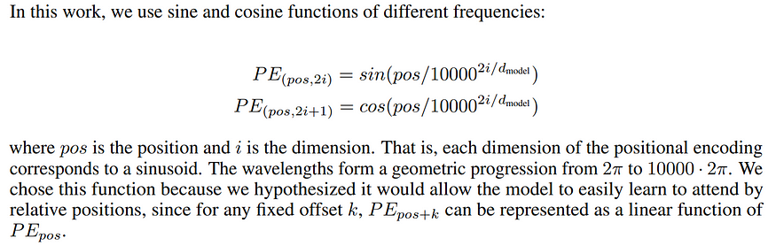
Transformer Network
There are multiple ways of defining these positional embeddings. For example in the original paper — Attention is All You Need, the authors used an alternating sine and cosine function to define the embeddings.

Slide 20
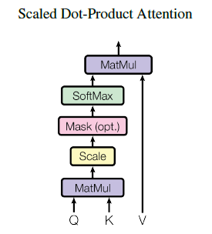
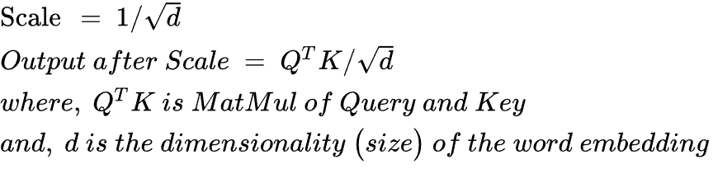

Transformer Network

Slide 21
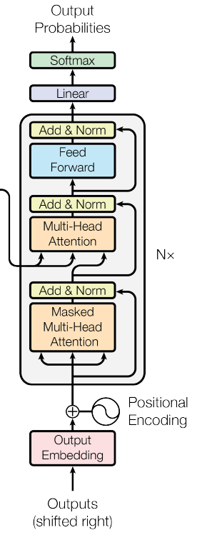
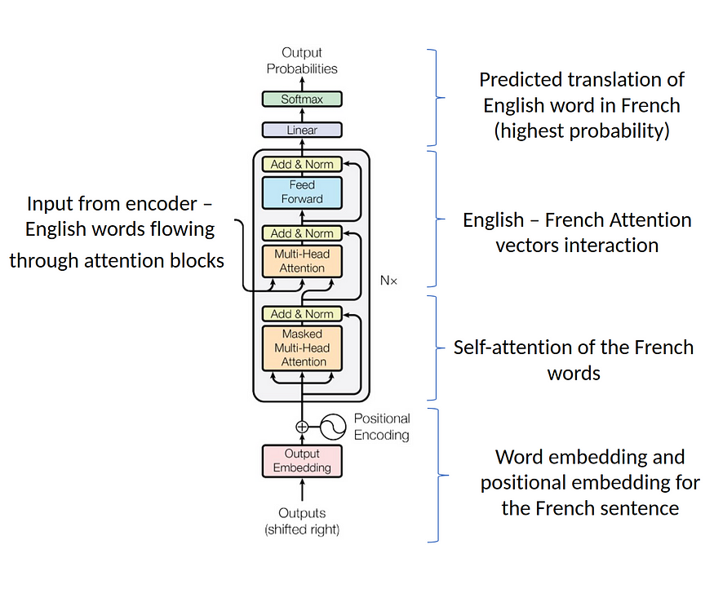
Decoder Block
Steps in Decoder Block (Eng – French Translation)
The output of the encoder is again a sequence of embeddings, one embedding per position, where each position embedding contains not only the embedding of the original word at the position but also information about other words, that it learned using attention.

Slide 22
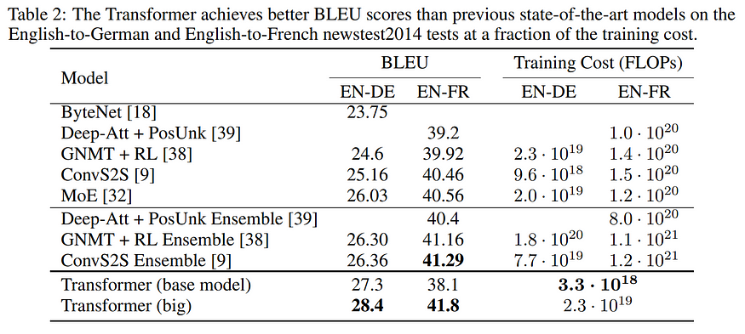
Results
In summary, a Transformer model can reduce computation costs while still obtaining state-of-the-art results.

Slide 23

GPT
[Generative Pre-trained Transformer]
Looking at how a question and its context passage are related, three main categories of questions can be recognized. Firstly, lexical matching questions that contain at least one word from the context passage. Secondly, questions that are related to the context passage through synonyms, antonyms or hypernyms belong to the category of paraphrasing questions. Thirdly, questions that can be answered using general world knowledge are categorized as pragmatics.

Slide 24
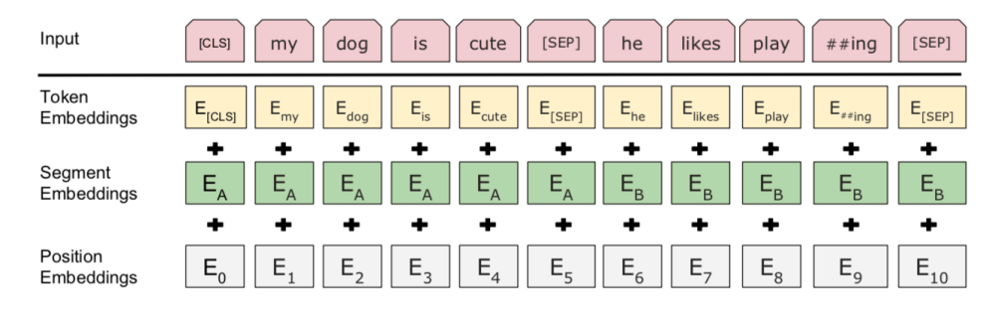
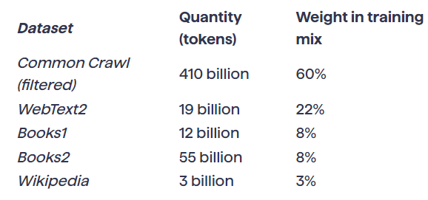
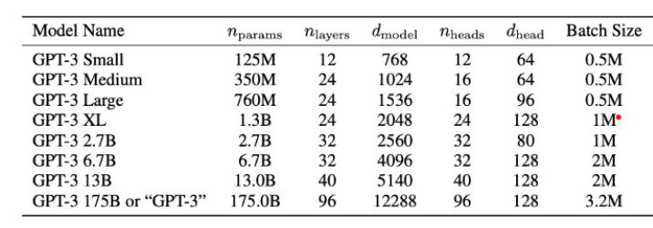
OpenAI GPT Model
OpenAI’s GPT3 model is trained on about 45 terabytes of text data.
It includes Wikipedia, common crawl (all websites crawled) and various books collections.

Slide 25
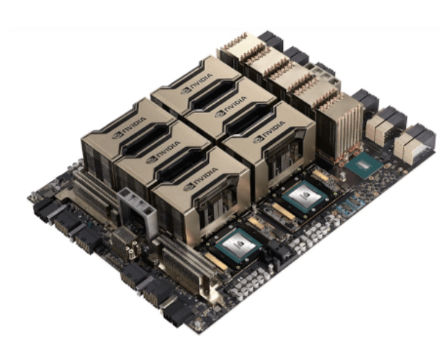
Training of GPT Model
Basic training process is simple as below:
You present a batch of examples, and then you adjust the weights in the network to minimize the error (“loss”) that the network makes on those examples. The main thing that’s expensive about “back propagating” from the error is that each time you do this, every weight in the network will typically change at least a tiny bit, and there are just a lot of weights to deal with.
With modern GPU hardware, it’s straightforward to compute the results from batches of thousands of examples in parallel. But when it comes to actually updating the weights in the neural net, current methods require one to do this basically batch by batch. (And, yes, this is probably where actual brains—with their combined computation and memory elements—have, for now, at least an architectural advantage.)

Slide 26
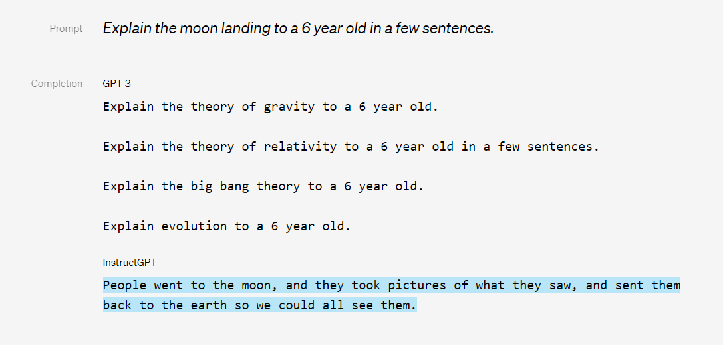
Beyond Basic Training
A key idea in the construction of ChatGPT was to have another step after “passively reading” things like the web: to have actual humans actively interact with ChatGPT, see what it produces, and in effect give it feedback on “how to be a good chatbot”.

Slide 27
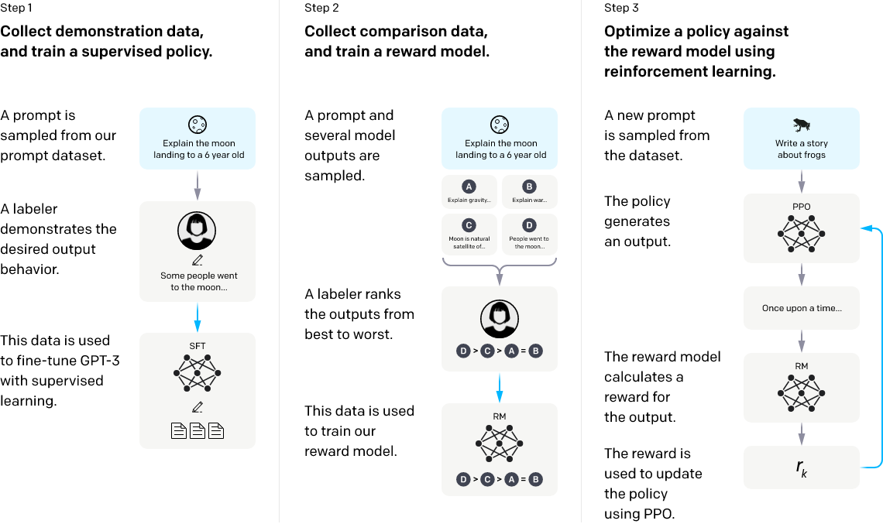
Beyond Basic Training

Slide 28
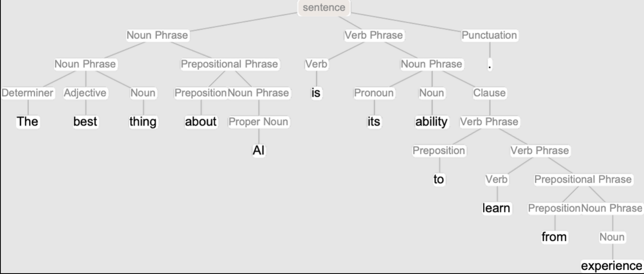
What really lets ChatGPT work?
Simple answer is “HUMAN LANGUAGE”
And indeed it’s seemed somewhat remarkable that human brains—with their network of a “mere” 100 billion or so neurons (and maybe 100 trillion connections) could be responsible for it. Perhaps, one might have imagined, there’s something more to brains than their networks of neurons—like some new layer of undiscovered physics. But now with ChatGPT we’ve got an important new piece of information: we know that a pure, artificial neural network with about as many connections as brains have neurons is capable of doing a surprisingly good job of generating human language.
Language is not just a random jumble of words. Instead, there are (fairly) definite grammatical rules for how words of different kinds can be put together: in English, for example, nouns can be preceded by adjectives and followed by verbs, but typically two nouns can’t be right next to each other. Such grammatical structure can (at least approximately) be captured by a set of rules that define how what amount to “parse trees” can be put together:

Slide 29
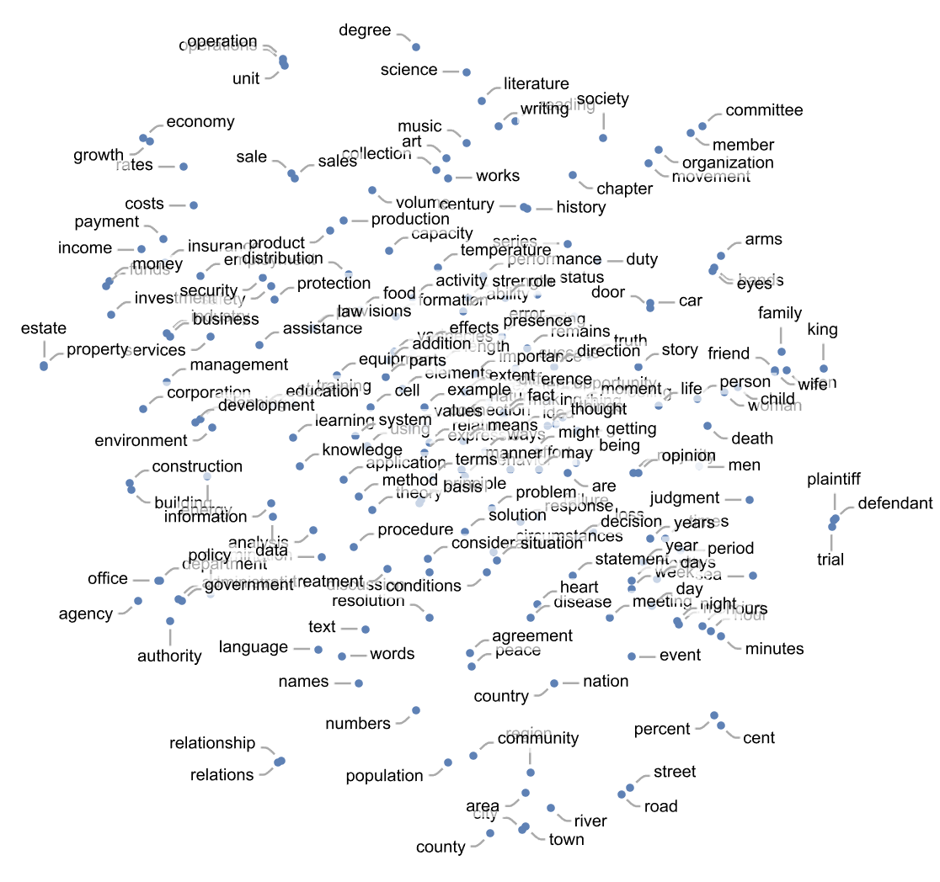
What really lets ChatGPT work?
ChatGPT doesn’t have any explicit “knowledge” of such rules. But somehow in its training it implicitly “discovers” them—and then seems to be good at following them. So how does this work? At a “big picture” level it’s not clear. But to get some insight it’s perhaps instructive to look at a much simpler example.
Inside ChatGPT any piece of text is effectively represented by an array of numbers that we can think of as coordinates of a point in some kind of “linguistic feature space”. So when ChatGPT continues a piece of text this corresponds to tracing out a trajectory in linguistic feature space. But now we can ask what makes this trajectory correspond to text we consider meaningful. And might there perhaps be some kind of “semantic laws of motion” that define—or at least constrain—how points in linguistic feature space can move around while preserving “meaningfulness”?

Slide 30
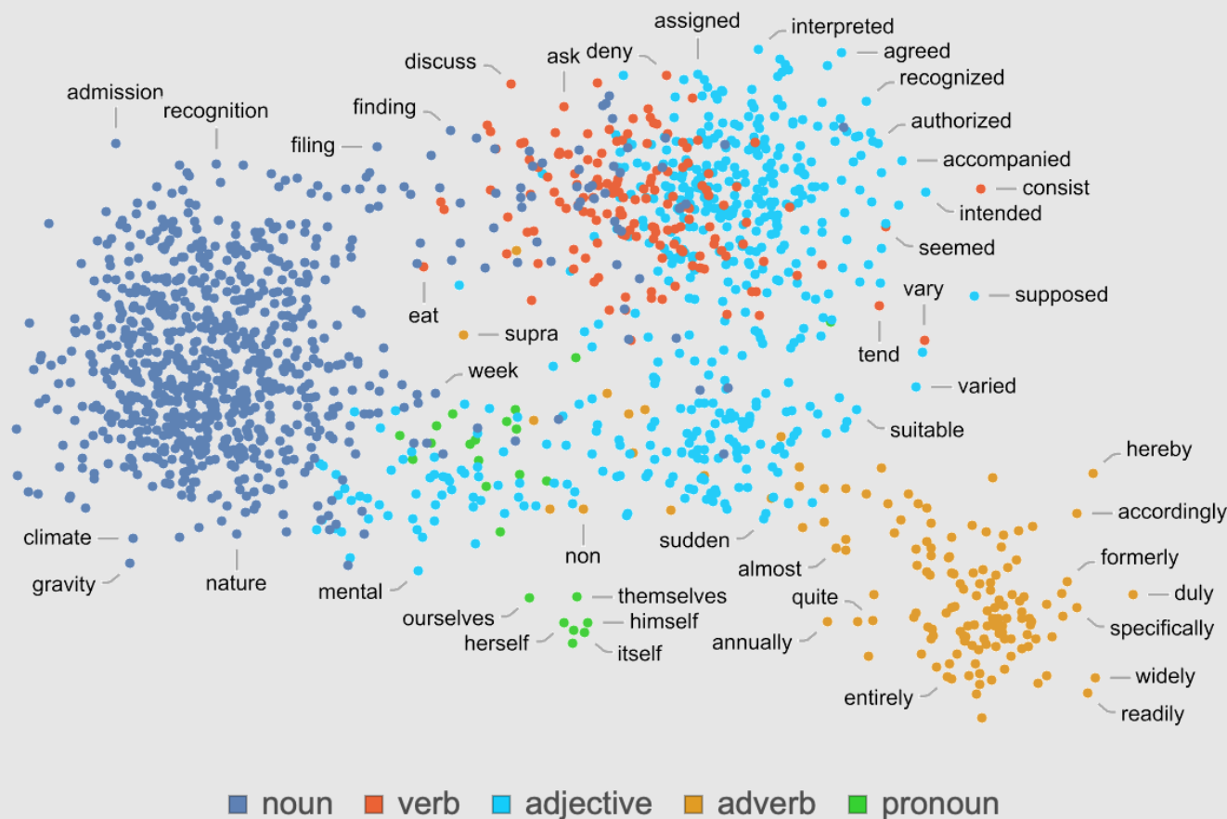
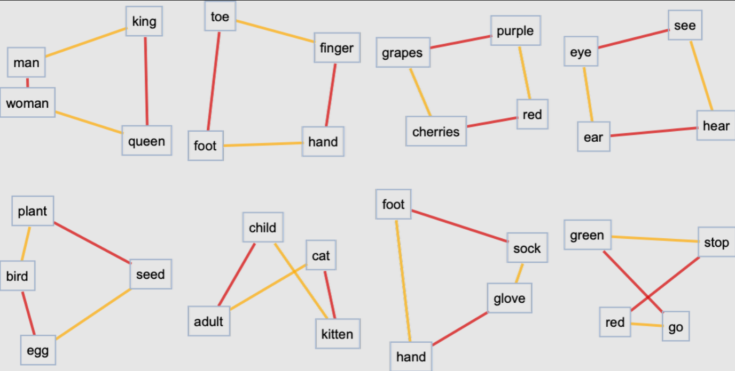
What really lets ChatGPT work?
OK, so it’s at least plausible that we can think of this feature space as placing “words nearby in meaning” close in this space. But what kind of additional structure can we identify in this space? Is there for example some kind of notion of “parallel transport” that would reflect “flatness” in the space? One way to get a handle on that is to look at analogies.

Slide 31
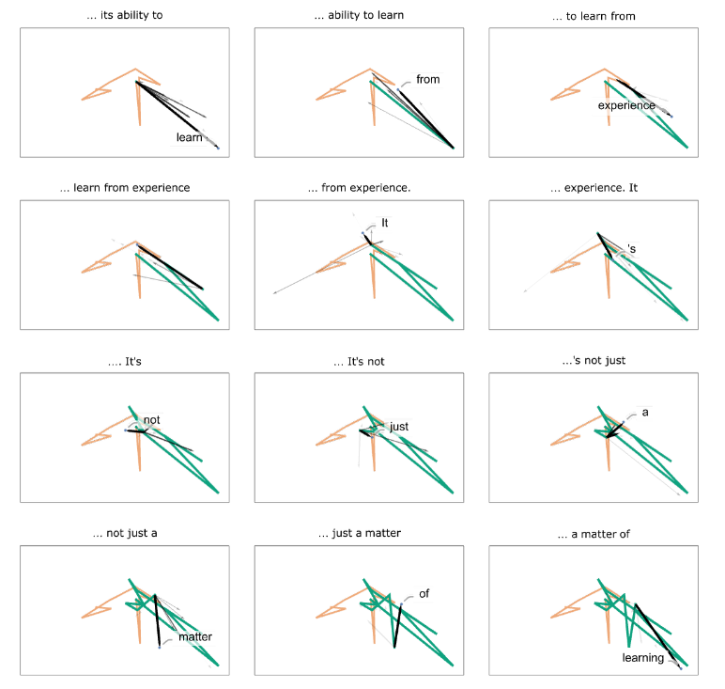
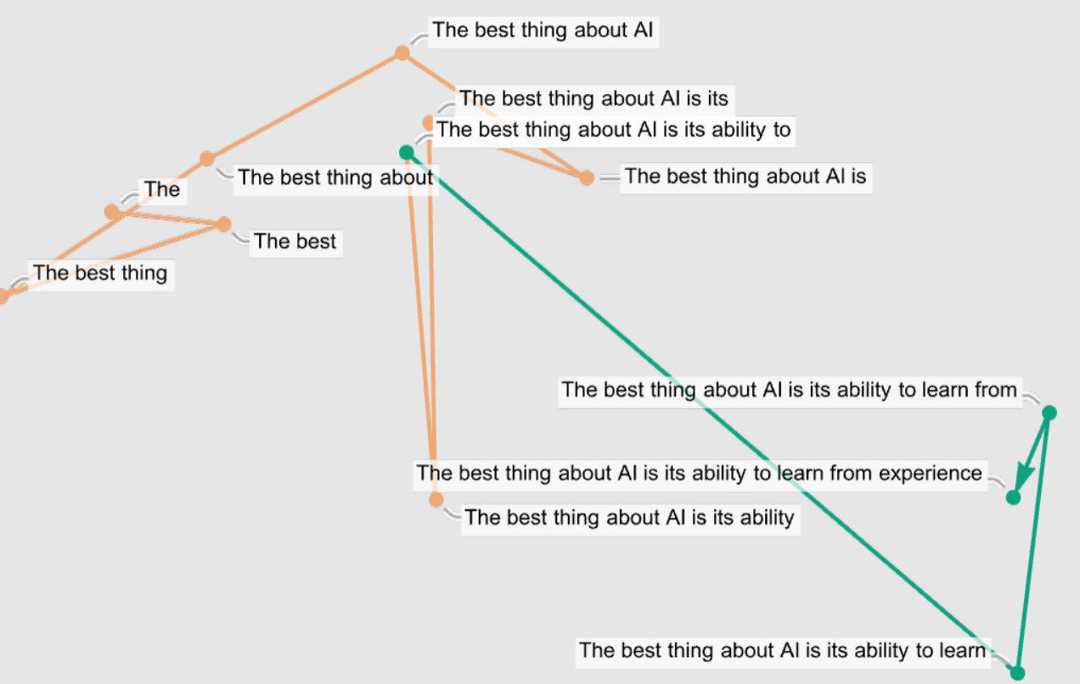
What really lets ChatGPT work?
So what about trajectories? We can look at the trajectory that a prompt for ChatGPT follows in feature space—and then we can see how ChatGPT continues that:

Slide 32
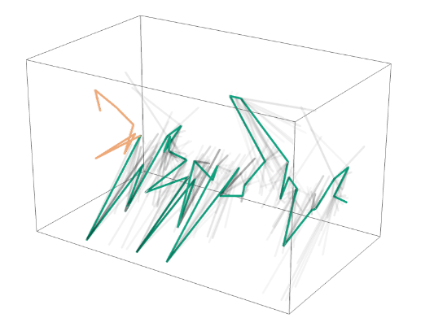
What really lets ChatGPT work?
You can visualize all the 40 steps in 3D view as below:
And, yes, this seems like a mess—and doesn’t do anything to particularly encourage the idea that one can expect to identify “mathematical-physics-like” “semantic laws of motion” by empirically studying “what ChatGPT is doing inside”. But perhaps we’re just looking at the “wrong variables” (or wrong coordinate system) and if only we looked at the right one, we’d immediately see that ChatGPT is doing something “mathematical-physics-simple” like following geodesics. But as of now, we’re not ready to “empirically decode” from its “internal behavior” what ChatGPT has “discovered” about how human language is “put together”.

Slide 33

What ChatGPT is doing exactly?
The basic concept of ChatGPT is at some level rather simple. Start from a huge sample of human-created text from the web, books, etc. Then train a neural net to generate text that’s “like this”. And in particular, make it able to start from a “prompt” and then continue with text that’s “like what it’s been trained with”. As we’ve seen, the actual neural net in ChatGPT is made up of very simple elements—though billions of them. And the basic operation of the neural net is also very simple, consisting essentially of passing input derived from the text it’s generated so far “once through its elements” (without any loops, etc.) for every new word (or part of a word) that it generates.
What ChatGPT does in generating text is very impressive—and the results are usually very much like what we humans would produce. So does this mean ChatGPT is working like a brain? Its underlying artificial-neural-net structure was ultimately modeled on an idealization of the brain. And it seems quite likely that when we humans generate language many aspects of what’s going on are quite similar.

Slide 34


Where to go from here?
It’s very exciting to see what ChatGPT has already been able to do. At some level it’s a great example of the fundamental scientific fact that large numbers of simple computational elements can do remarkable and unexpected things. But it also provides perhaps the best impetus we’ve had in two thousand years to understand better just what the fundamental character and principles might be of that central feature of the human condition that is human language and the processes of thinking behind it.

Slide 35

Where to go from here?
This is a response from ChatGPT itself about its own (supposedly) future.
It should be noted that ChatGPT is a software service provided by OpenAI (which isn’t open anymore as there latest model details (i.e., GPT4) haven’t been released for public).
There are plenty of open source alternatives to ChatGPT which can be trained on our own data and then interact with us in Chat-like fashion like ChatGPT.

Slide 36


Alternate Models
BingAI from Microsoft
BARD AI from Google
BLOOM (open source)
Llama (Open source from Meta)
Various others ….

Slide 37


AI Takeover?
There is no clearcut answer to this doomsday type of question.
Let’s keep it as a food for thought for everybody ?
What are your thoughts and why you think what you think about this existential (or seemingly) question?

